Slide 1

Java Advanced Features
CCS0023/L
Object Oriented Programming (Java)

Slide 2
13
LESSON #13
Java Advanced Features
Threads

Slide 3
Regular Expressions
Database Helper
JDBC

Slide 4
Regular Expressions
A regular expression is a specially formatted String that describes a search pattern matching characters in other Strings. They can be used to search, edit, or manipulate text and data.

Slide 5
Character Classes
Construct | Meaning
[abc] | a, b, or c (simple class)
[^abc] | Any character except a, b, or c (negation)
[a-zA-Z] | a through z, or A through Z, inclusive (range)
[a-d[m-p]] | a through d, or m through p: [a-dm-p] (union)
[a-z&&[def]] | d, e, or f (intersection)
[a-z&&[^bc]] | a through z, except for b and c: [ad-z] (subtraction)
[a-z&&[^m-p]] | a through z, and not m through p: [a-lq-z] (subtraction)

Slide 6
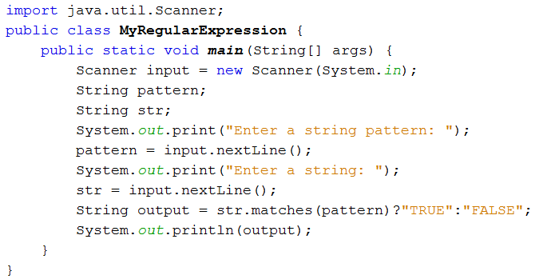
Program Simulation

Slide 7
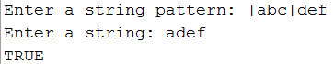
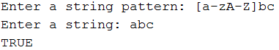
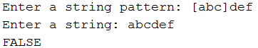
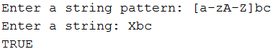
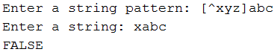
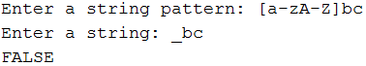
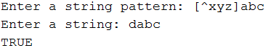
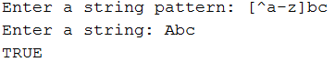
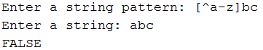

Slide 8
Predefined Character Class
Character | Matches
. | any character
\d | any digit: [0-9]
\w | any word character: [a-zA-Z_0-9]
\s | any white-space character: [\t\n\x08\f\r]
\D | any nondigit: [^0-9]
\W | any nonword character: [^\w]
\S | any nonwhite-space character: [^\s]

Slide 9
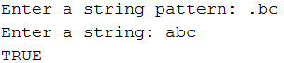
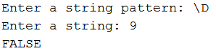
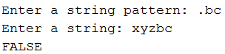
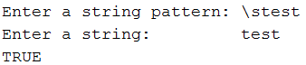
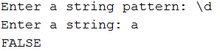
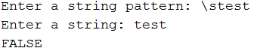
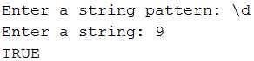
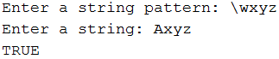
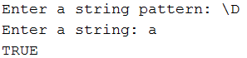
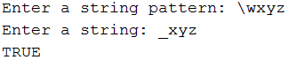

Slide 10
Quantifiers
Allow you to specify the number of occurrences to match against.
Quantifier | Meaning
a? | a, once or not at all
a* | a, zero or more times
a+ | a, one or more times
a{n} | a, exactly n times
a{n,} | a, at least n times
a{n,m} | a, at least n but not more than m times

Slide 11
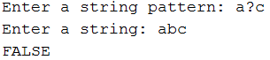
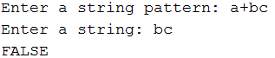
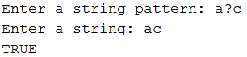
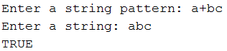
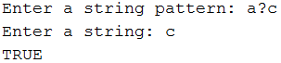
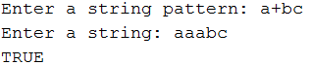
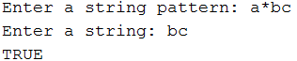
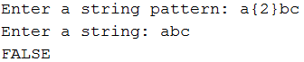
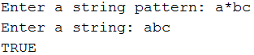
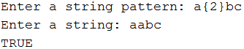
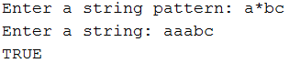

Slide 12
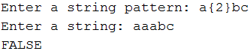
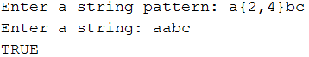
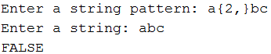
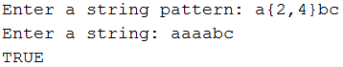
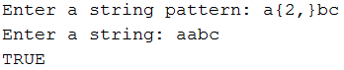
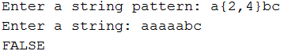
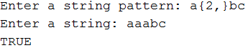
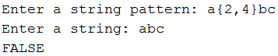

Slide 13
Boundary Matchers
Boundary Construct | Description
^ | The beginning of a line
$ | The end of a line
\b | A word boundary
\B | A non-word boundary
\A | The beginning of the input
\G | The end of the previous match
\Z | The end of the input but for the final terminator, if any
\z | The end of the input

Slide 14
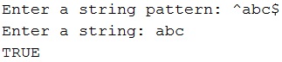
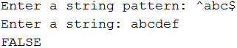
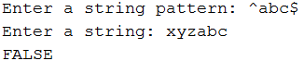
http://docs.oracle.com/javase/tutorial/essential/regex/bounds.html

Slide 15
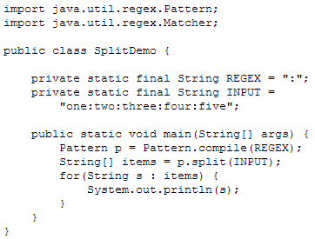
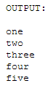
Pattern class
The Pattern class defines a convenient matches method that allows you to quickly check if a pattern is present in a given input string

Slide 16
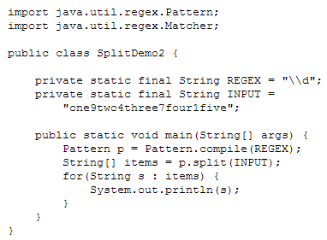
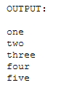

Slide 17
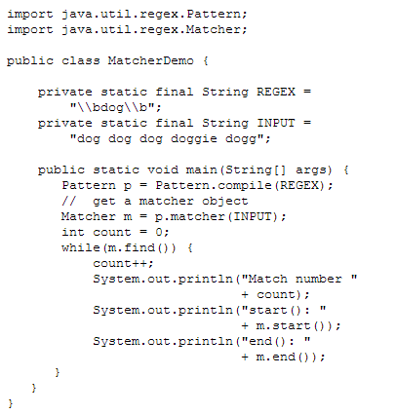
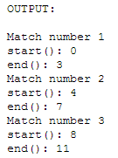
Matcher Class
Using the start and end Methods

Slide 18
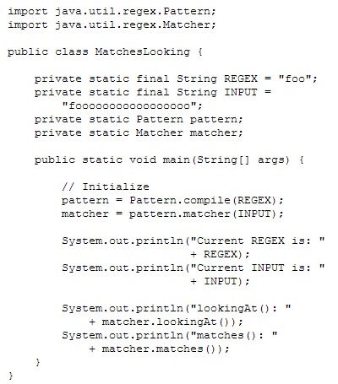
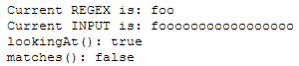
Using the matches and lookingAt Methods

Slide 19

Using replaceFirst(String) and replaceAll(String)

Slide 20


Slide 21

Using appendReplacement(StringBuffer,String) and appendTail (StringBuffer)

Slide 22
Java JDBC

Slide 23
Database
is an organized collection of data.
DBMS
provides mechanisms for storing, organizing, retrieving and modifying data for many users. It allows for the access and storage of data without
concern for the internal representation of data.
Popular RDBMS
MSSQL Server, Oracle, Sybase, IBM DB2, Informix, PostgreSLQ, MySQL and Java DB (Oracle’s version of Apache Derby).
Java Database Connectivity (JDBCTM)
used to communicate Java programs with database and manipulate their data

Slide 24

JDBC Driver
enables Java applications to connect to a database in a particular DBMS and allows you to manipulate that database using the JDBC API.
Relational Database
is a logical representation of data that allows the data to be accessed without consideration of its physical structure.
data are stored in a table

Slide 25
Primary Key
a column (or group of columns) with a unique value that cannot be duplicated in other rows. (ex. sss, employee ID, student ID, item code, part of some table that has unique identification)
Foreign Keys
also allow related data in multiple tables to be selected from those tables for analytic purposes—this is known as joining the data.
Foreign keys are specified when creating a table. The foreign key helps maintain the Rule of Referential Integrity—every foreign-key value must appear as another table’s primary-key value. This enables the DBMS to determine whether the AuthorID value for a particular book is valid.

Slide 26
Entity Relationship Diagram (ERD)
is a data modeling technique that creates a graphical representation of the entities, and the relationships between entities, within an information system.
Database Normalization
is the process of organizing the fields and tables or a relational database to minimize the redundancy of data. Table keys are used to make tables relationship which follow the Rule of Entity Integrity.

Slide 27

Figure 8.1 Table relationship in the books database

Slide 28

SQL (pronounced as Sequel)
Table 8.2 SQL Keywords

Slide 29
SQL Syntax
SELECTING RECORDS
SELECT * FROM tableName
Where
* - a wildcard for all fields or columns
SELECT columnName1, columnName2, … FROM tableName
SELECT columnName1, columnName2, … FROM tableName WHERE criteria

Slide 30
SELECT columnName1, columnName2, … FROM tableName WHERE criteria LIKE ‘<like pattern>’
A pattern that contains a percent character (%) searches for strings that have zero or more characters at the percent character’s position in the pattern.
An underscore ( _ ) in the pattern string indicates a single wildcard character at that position in the pattern.

Slide 31
SELECT * FROM tableName ORDER BY columnName ASC|DESC
SELECT columnName1, columnName2, …
FROM table1
INNER JOIN table2
ON table1.columnName = table2.columnName
The INNER JOIN operator merges rows from two tables by matching values in columns that are common to the tables
The ON clause of the INNER JOIN specifies the columns from each table that are compared to determine which rows are merged.

Slide 32
ADDING RECORDS
INSERT INTO tableName ( columnName1, columnName2, …, columnNameN )
VALUES ( value1, value2, …, valueN )
UPDATING RECORDS
UPDATE tableName
SET columnName1 = value1, columnName2 = value2, …, columnNameN = valueN
WHERE criteria

Slide 33

DELETING RECORDS
DELETE FROM tableName WHERE criteria
Table 8.3 Popular JDBC database URL formats.

Slide 34

Program 8.1 Displaying Authors from MySQL DB
DisplayAuthors.java
a) Displaying Authors

Slide 35


Program 8.2 Querying dbbooks
ResultSetTableModel.java
DisplayQueryResults.java
a) Displaying all authors from
the Authors table
b) Displaying the the authors’ first and last names joined with the titles and edition numbers of the books they’ve authored

Slide 36

c) Filtering the results of the
previous query to show only the
books with Java in the title

Slide 37
Connecting to the Database
An object that implements interface Connection manages the connection between the Java program and the database. Connection objects enable programs to create
SQL statements that manipulate databases. The program initializes connection with the result of a call to static method getConnection of class DriverManager

Slide 38
PreparedStatements
Enables you to create compiled SQL statements that execute more efficiently than Statements. PreparedStatements can also specify parameters, making them more flexible than Statements—you can execute the same query repeatedly with different parameter values.
? – used as placeholders for values that will be passed as part of the query to the database.

